Slide 1
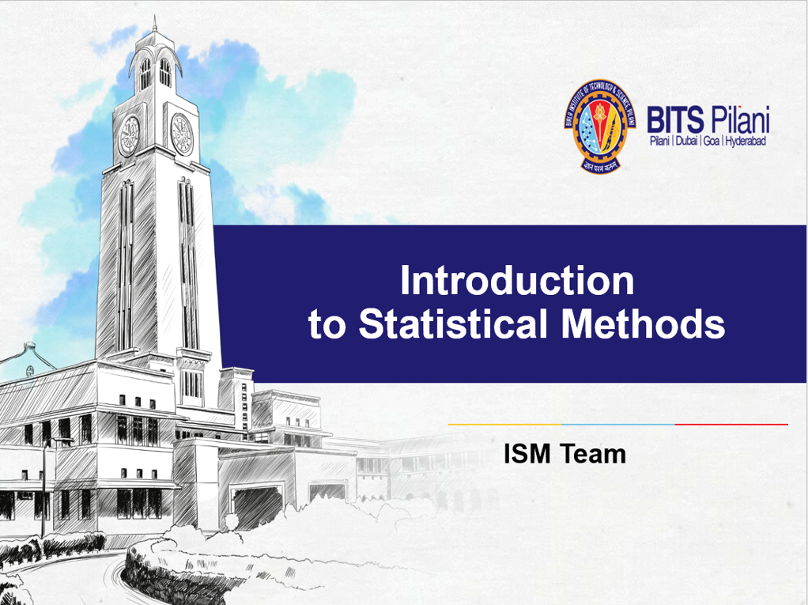
Introduction to Statistical Methods
Team ISM

Slide 2
Session 10
(Maximum Likelihood Estimation
&
ANOVA)
12th and 13th Aug 2023

Slide 3
Maximum Likelihood Estimation (MLE)
Method of Maximum Likelihood Estimation is the best and most popular one among all methods to obtain an almost good or best estimator for a population parameter.
It is a method of obtaining an estimator which most (maximum) likely estimates the true value of the parameter i.e., finding an estimator that can give most likely nearer value for the unknown true value of parameter.
The corresponding estimator is called maximum likelihood estimator (MLE).

Slide 4
Maximum Likelihood Estimation (MLE)
Suppose we have a random sample x₁,x₂, ..,x_{n} whose assumed probability distribution depends on some unknown parameter θ.
Ex:
1) For Binomial unknown parameters are n, p.
2) For Poisson unknown parameter is λ.
Our goal is to find good estimator of θ(population parameter) using sample and which can be done with the help of MLE.

Slide 5
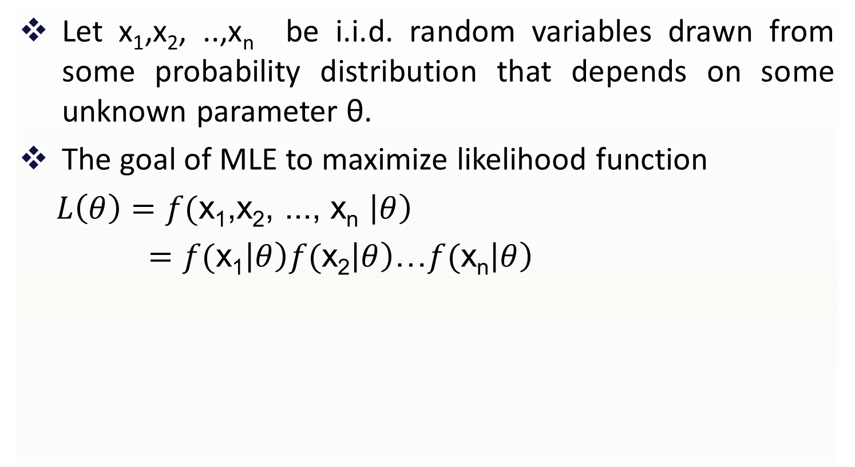
Maximum Likelihood function
Let x₁,x₂, ..,x_{n} be i.i.d. random variables drawn from some probability distribution that depends on some unknown parameter θ.
The goal of MLE to maximize likelihood function
$L\left(θ\right)=f($x₁,x₂, ..., x_{n} $\left|θ\right)$
$=f($x₁$\left|θ\right)f($x₂$\left|θ\right)$…$f($x_{n}$\left|θ\right)$

Slide 6
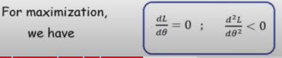
Maximum Likelihood Estimation (MLE)
The maximum likelihood estimate (MLE) of θ is that value of θ that maximizes likelihood(θ).
It is defined as

Slide 7
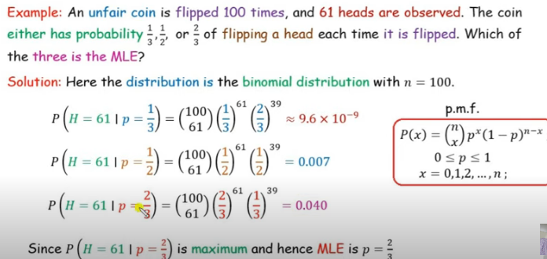

Slide 8
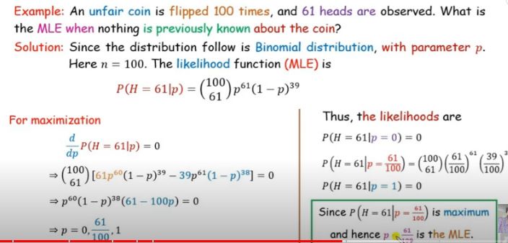

Slide 9
Maximum Likelihood for a Binomial distribution
Suppose we wish to find the maximum likelihood estimate (MLE) of θ for a Binomial distribution,

Slide 10
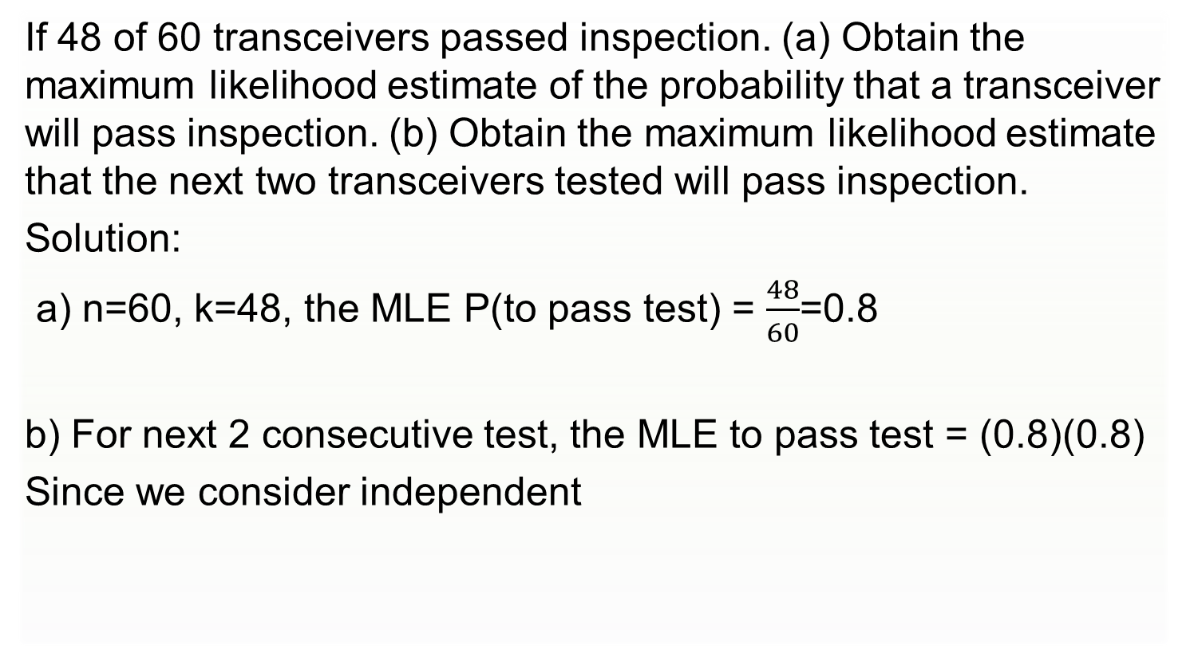
Example
If 48 of 60 transceivers passed inspection. (a) Obtain the maximum likelihood estimate of the probability that a transceiver will pass inspection. (b) Obtain the maximum likelihood estimate that the next two transceivers tested will pass inspection.
Solution:
a) n=60, k=48, the MLE P(to pass test) = $\frac{48}{60}$=0.8
b) For next 2 consecutive test, the MLE to pass test = (0.8)(0.8)
Since we consider independent

Slide 11
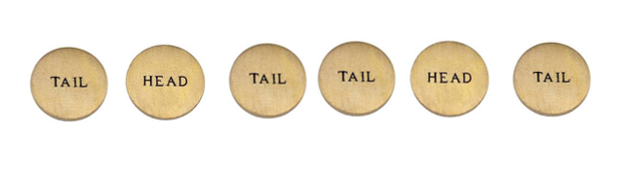
Maximum Likelihood Estimation
Example:
Consider a sample 0,1,0,0,1,0 from a binomial distribution, with the form P[X=0]=(1-p), P[X=1]=p. Find the maximum likelihood estimate of p.
Soln :

Slide 12
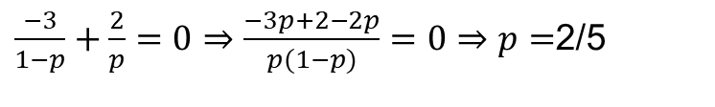
Maximum Likelihood Estimation
Example:
Consider a sample 0,1,0,0,1,0 from a binomial distribution, with the form P[X=0]=(1-p), P[X=1]=p. Find the maximum likelihood estimate of p.
Soln :
L(p)=P[X=0] P[X=1] P[X=0] P[X=0] P[X=1] P[X=0]
=(1-p) p (1-p) (1-p) p (1-p)
=(1-p)³p².
Log L(p)=log[(1-p)³p².]=log[(1-p)³]+log[(p²⁾.]=3log(1-p)+2logp
That is , there is 1/3 chance to observe this sample if we believe the population to be Binomial distributed .
$\frac{−3}{1−p}+\frac{2}{p}=0⇒\frac{−3p+2−2p}{p(1−p)}=0⇒p=$2/5

Slide 13
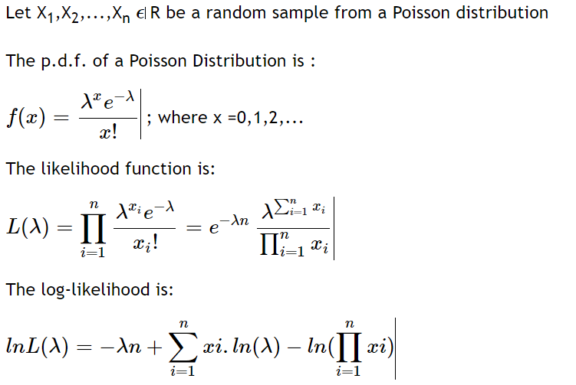
MLE for Poisson Distribution Parameter

Slide 14
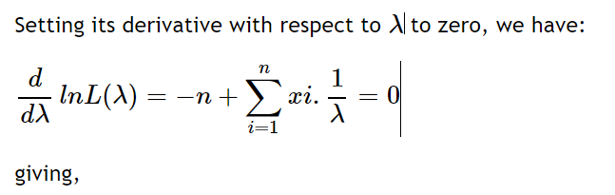
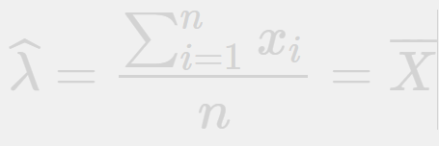
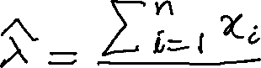
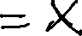
which is the maximum likelihood estimate

Slide 15
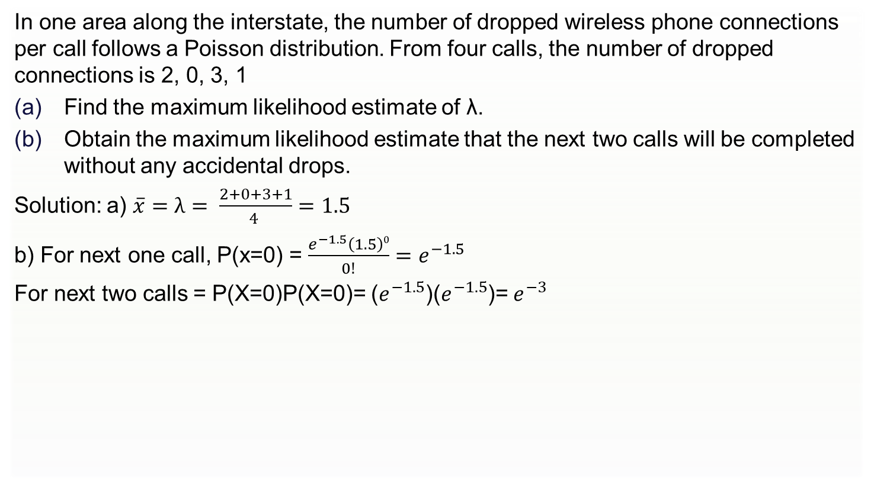
Example:
In one area along the interstate, the number of dropped wireless phone connections per call follows a Poisson distribution. From four calls, the number of dropped connections is 2, 0, 3, 1
Find the maximum likelihood estimate of λ.
Obtain the maximum likelihood estimate that the next two calls will be completed without any accidental drops.
Solution: a) $\overline{x}=λ= \frac{2+0+3+1}{4 }=1.5$
b) For next one call, P(x=0) = $\frac{e^{−1.5}\left(1.5\right)0}{0!}=e^{−1.5}$
For next two calls = P(X=0)P(X=0)= ($e^{−1.5}$)($e^{−1.5}$)= $e^{−3}$

Slide 16
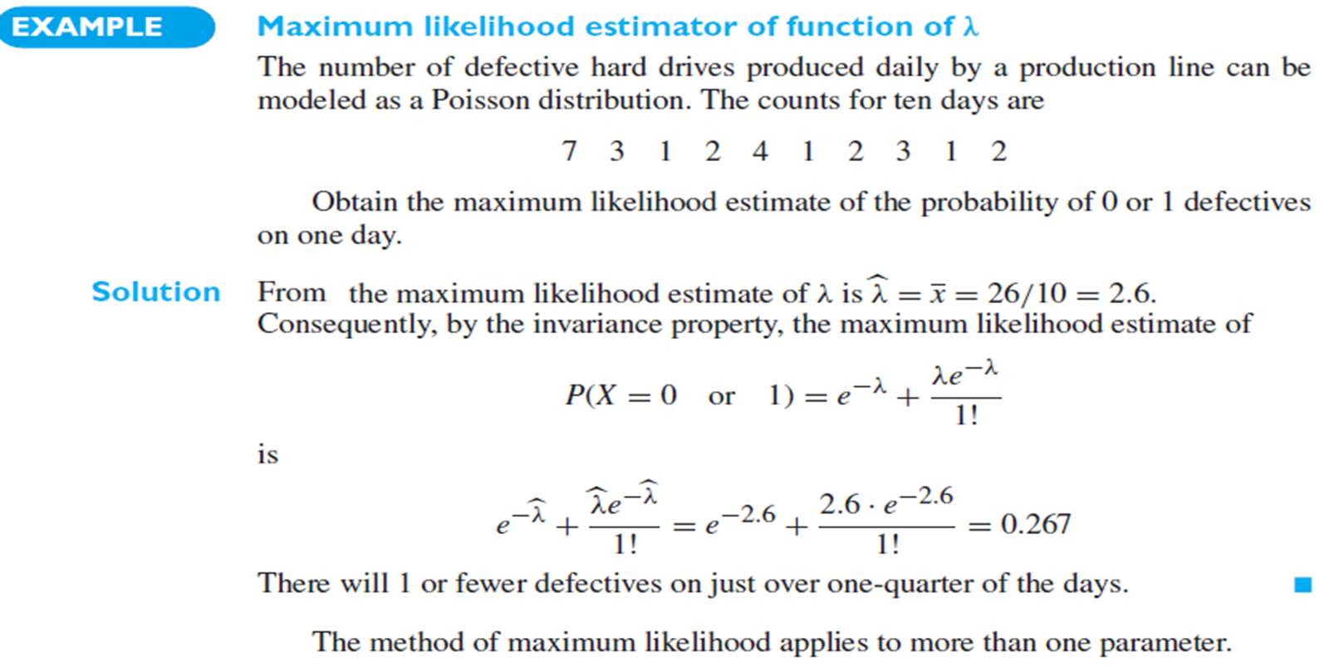

Slide 17
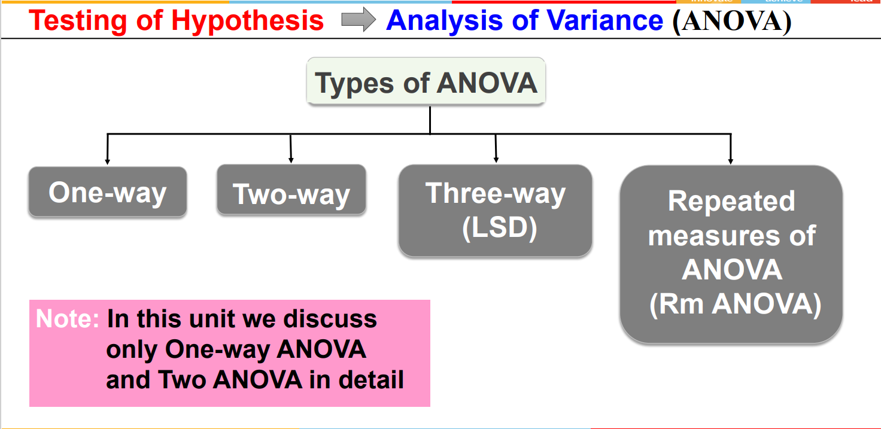

Slide 18
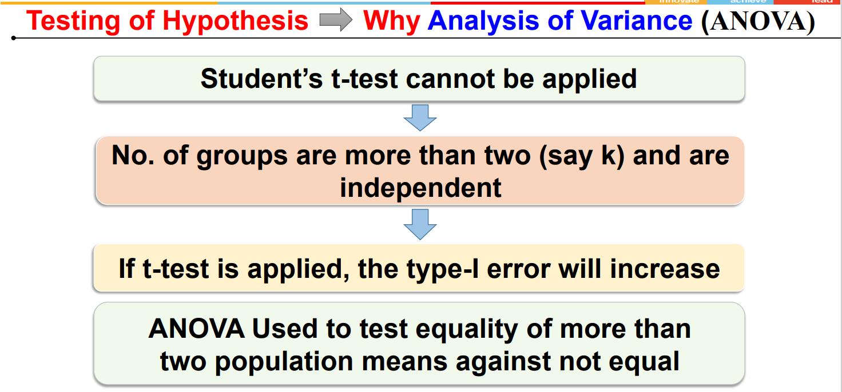

Slide 19
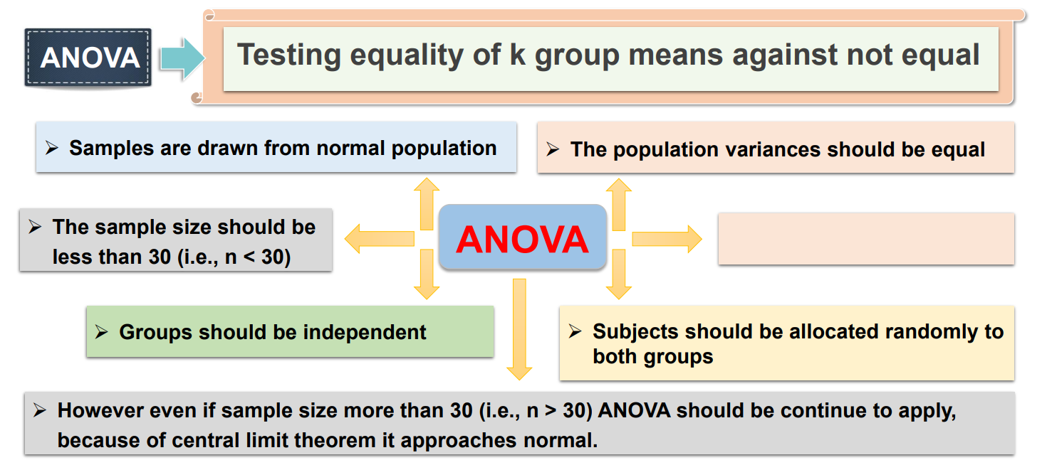

Slide 20
One-way ANOVA
ANOVA is a statistical technique used to determine whether differences exist among three or more population means.
In one-way ANOVA the effect of one factor on the mean is tested. It is based on independent random samples drawn from k – different levels of a factor, also called treatments.
The following notations are used in one-way ANOVA. The data can be represented in the following tabular structure.

Slide 21
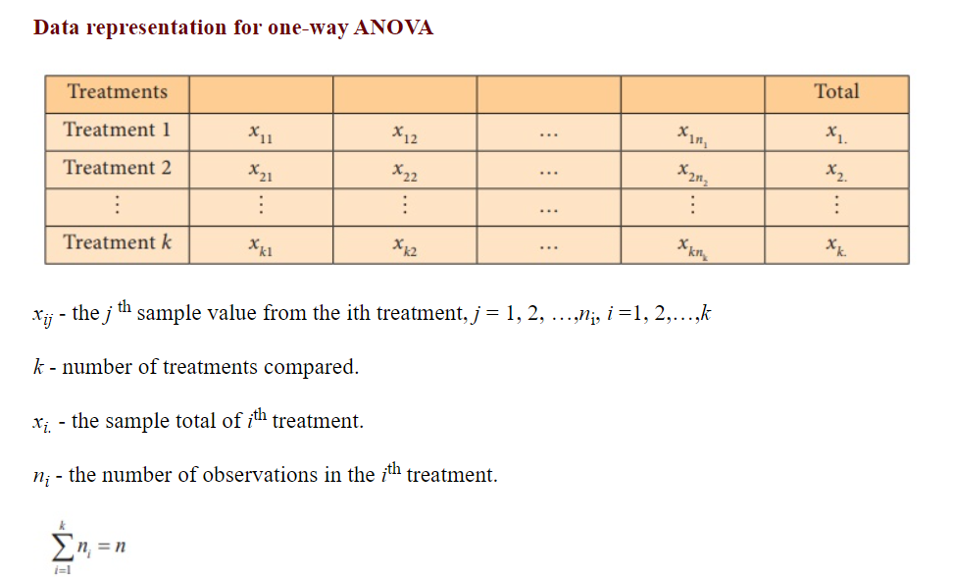
Total number of samples=n ; divided into k treatments

Slide 22
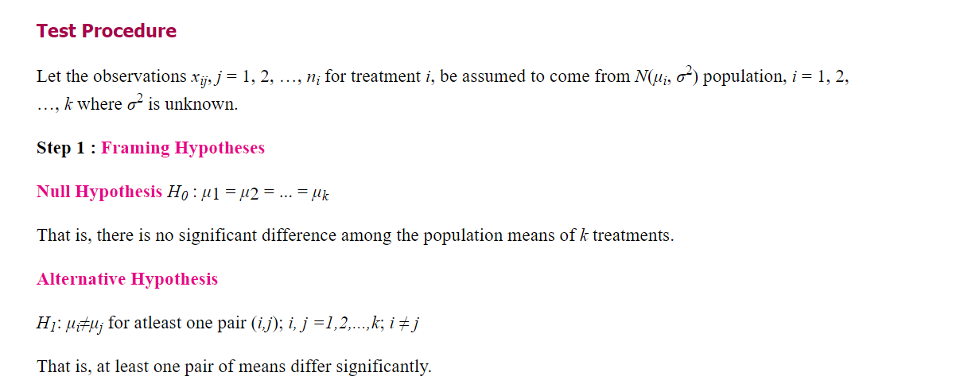

Slide 23
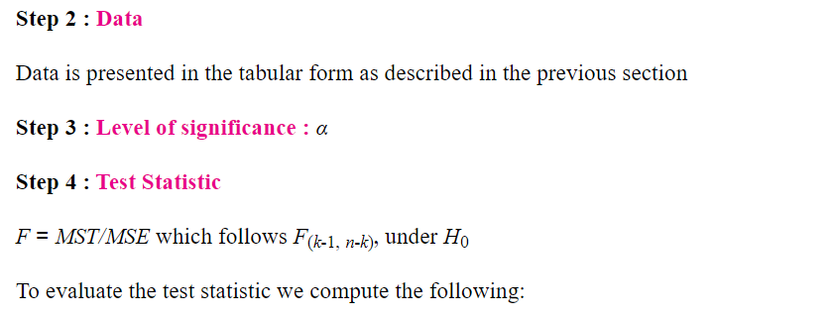
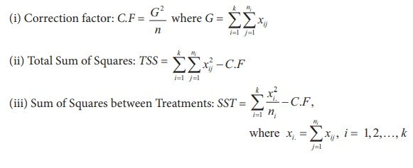

Slide 24
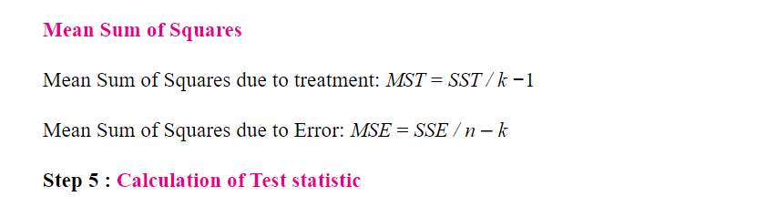

Slide 25
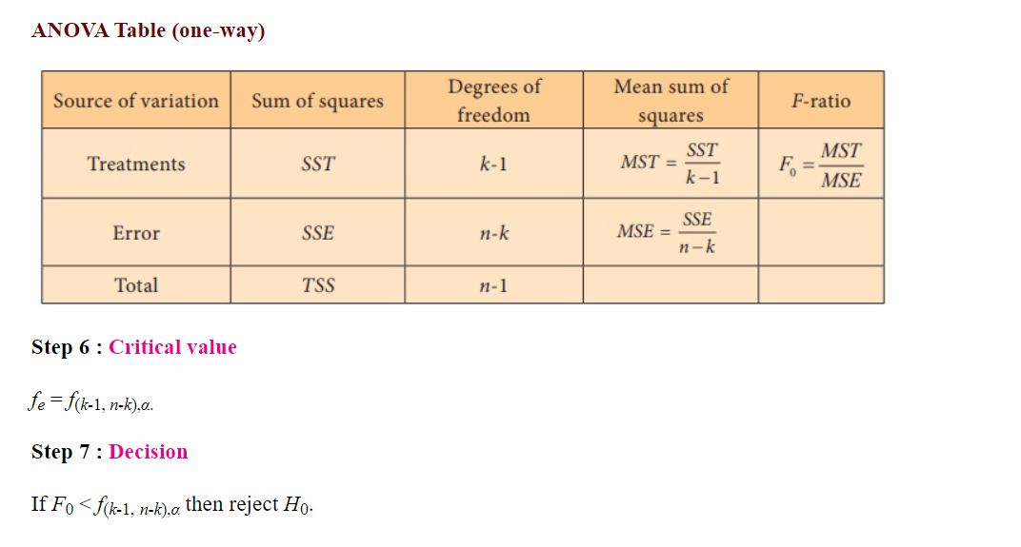
If less, then accept Ho

Slide 26
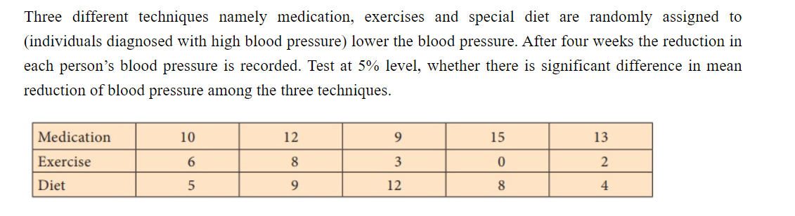
Example:1

Slide 27
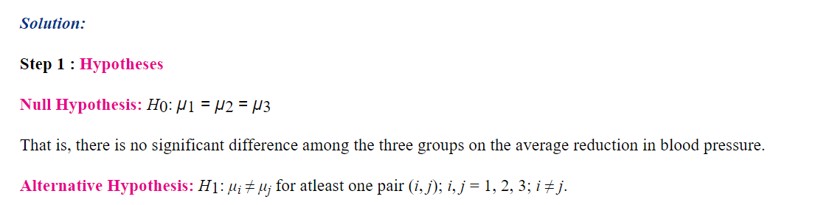
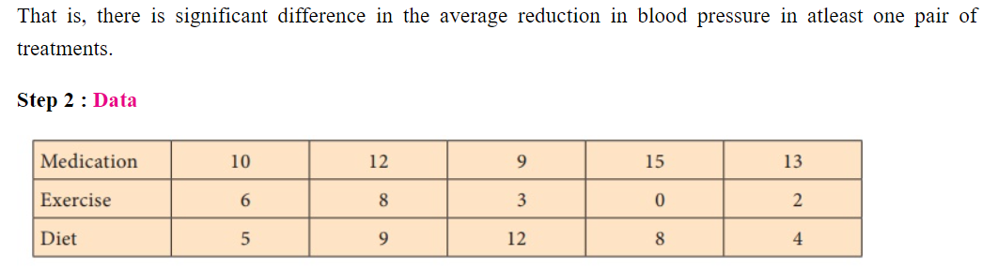

Slide 28
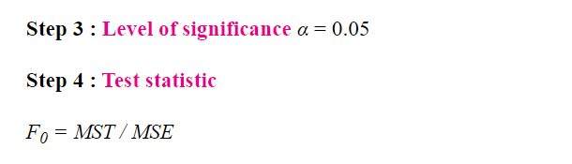
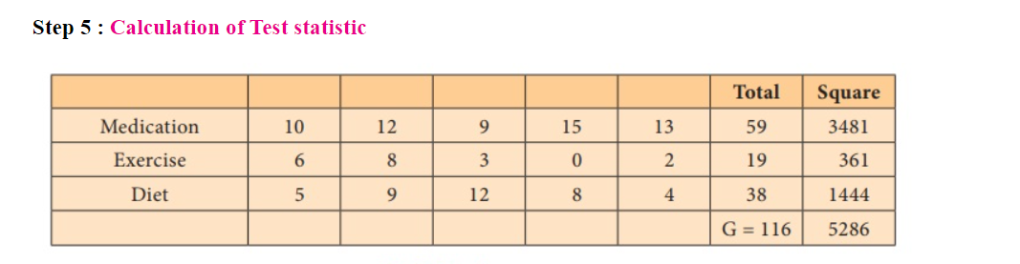

Slide 29
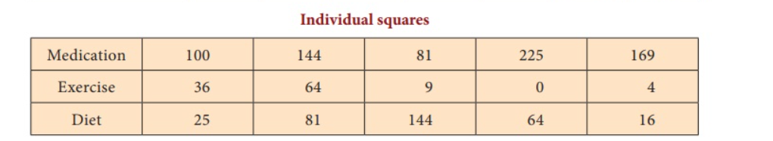
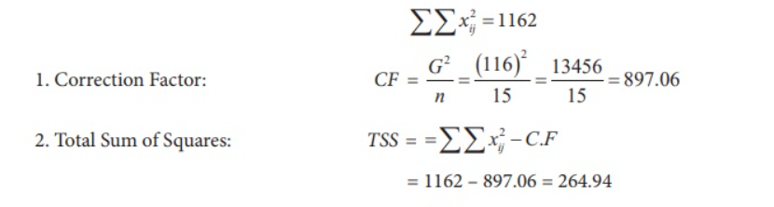
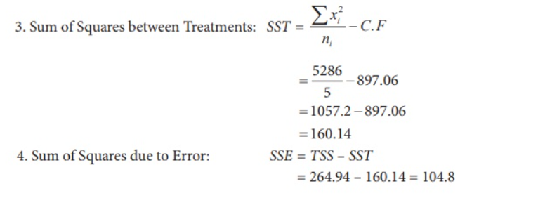

Slide 30
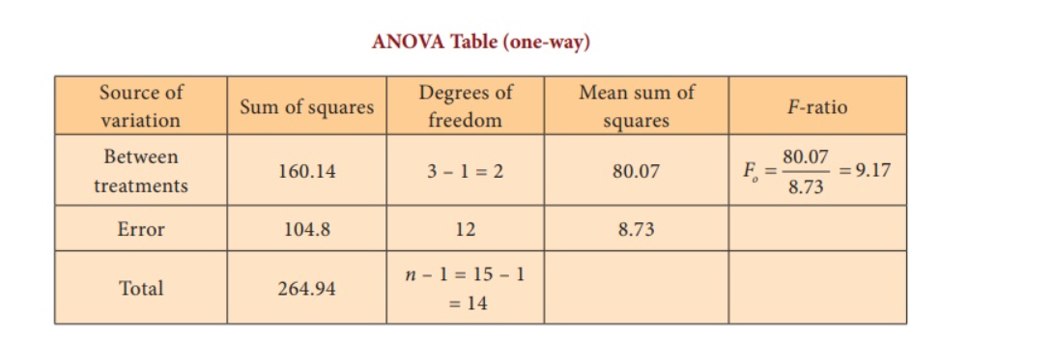

Slide 31
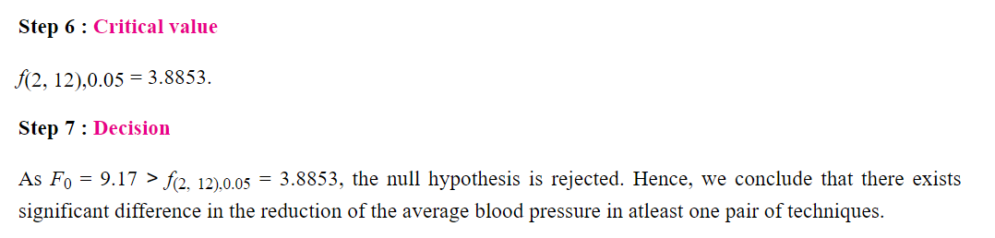

Slide 32
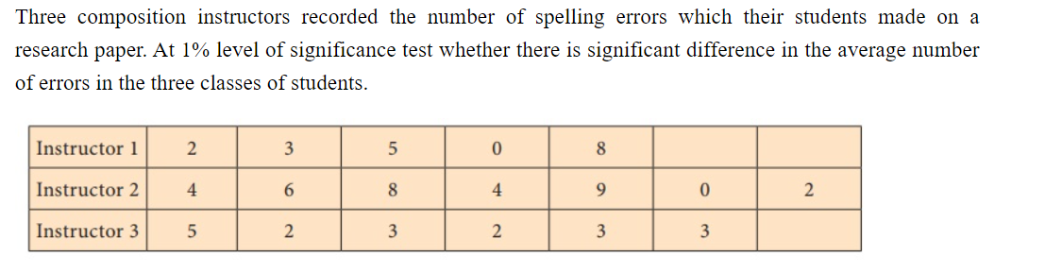
Example :2

Slide 33
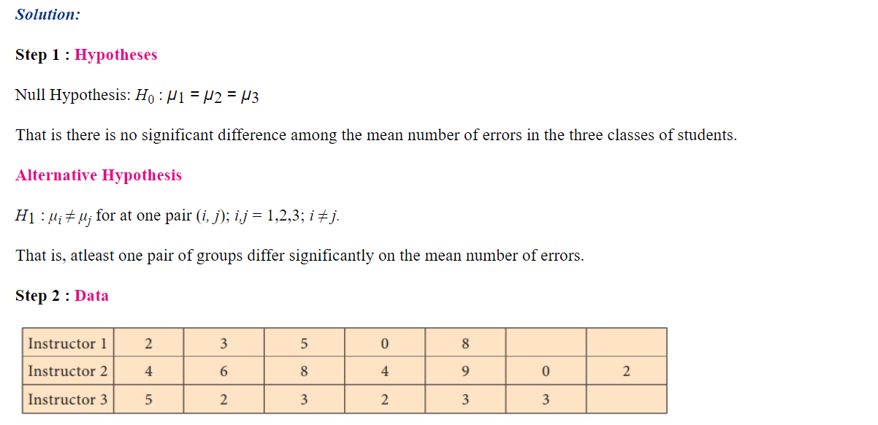

Slide 34
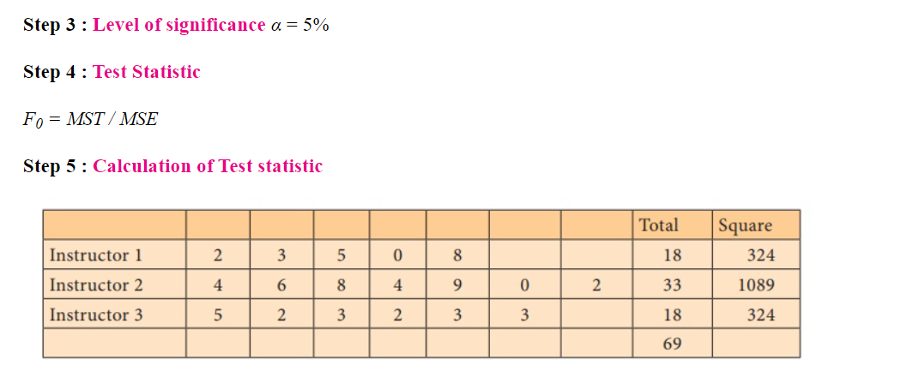

Slide 35
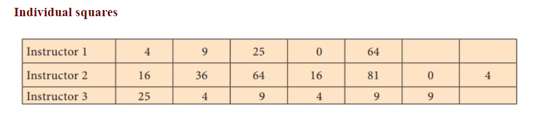
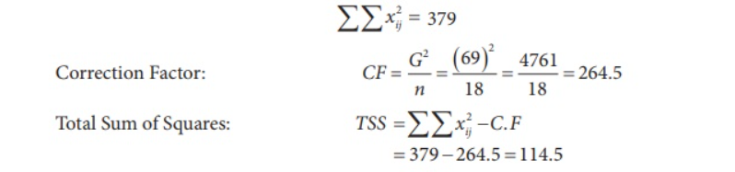

Slide 36
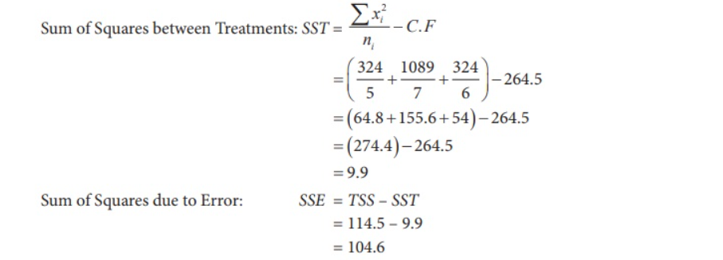

Slide 37
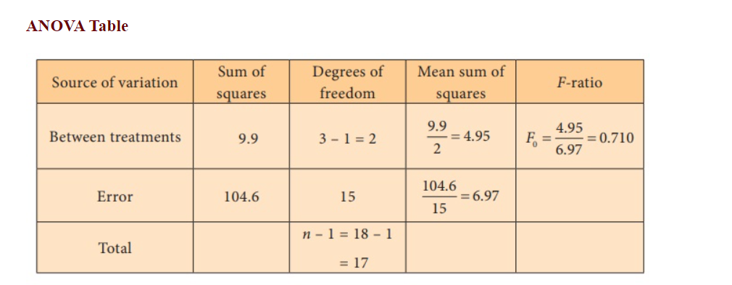

Slide 38
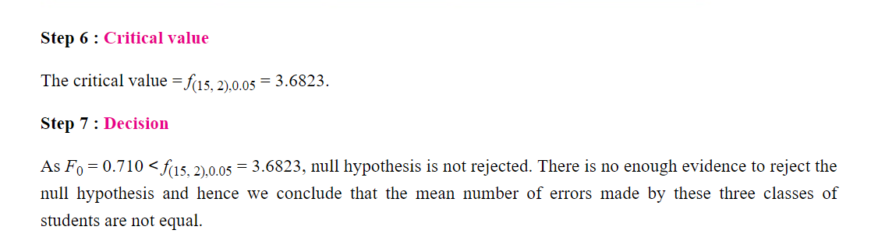
f(2,15),0.01 = 6.35
As 0.710<6.35 -> Accept H0
p-value equals 0.508553

Slide 39
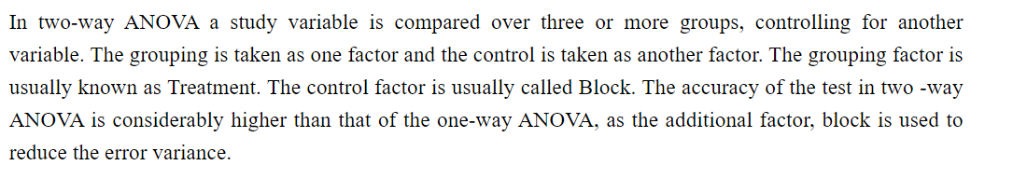
TWO-WAY CLASSIFICATION

Slide 40
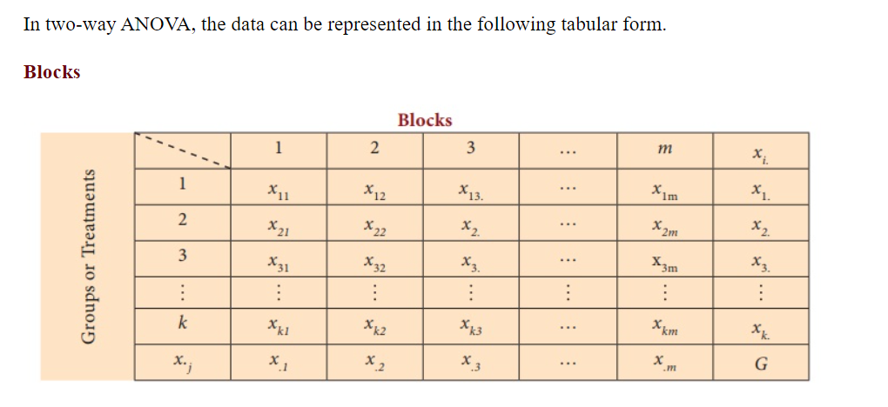

Slide 41
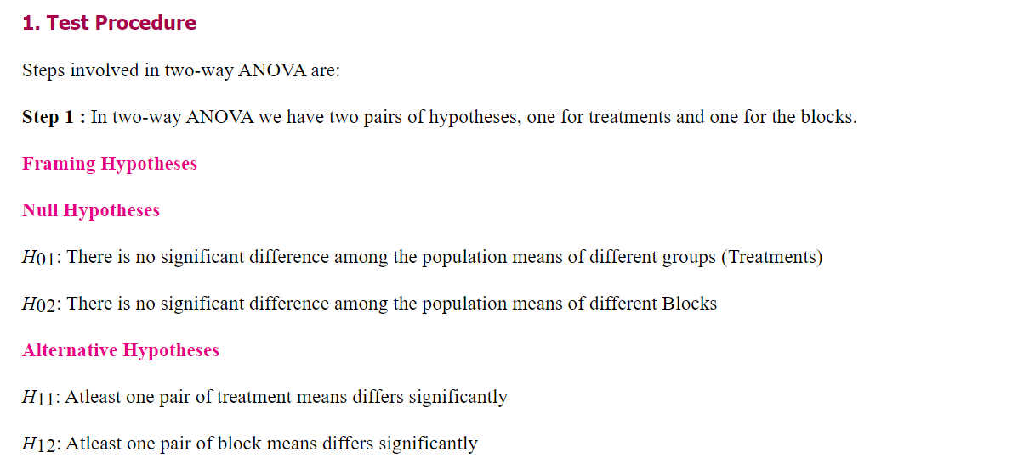

Slide 42
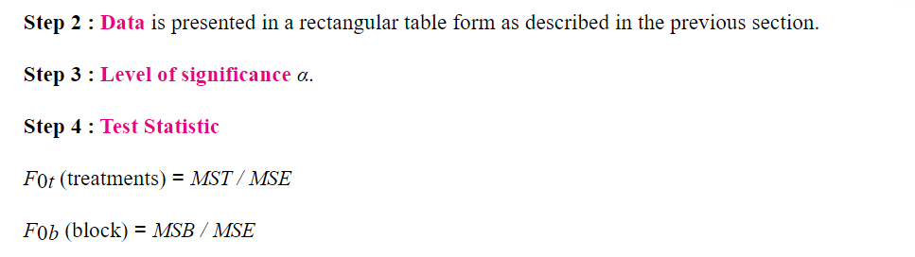

Slide 43
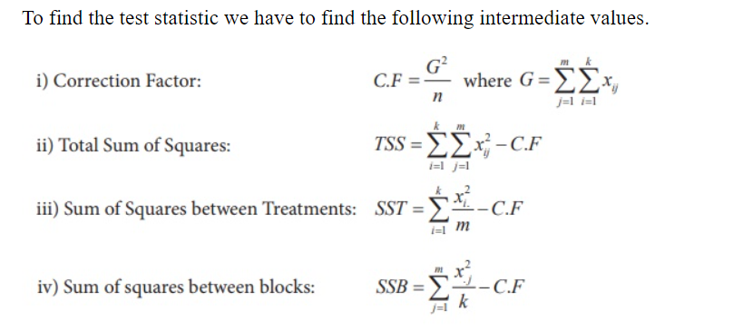

Slide 44
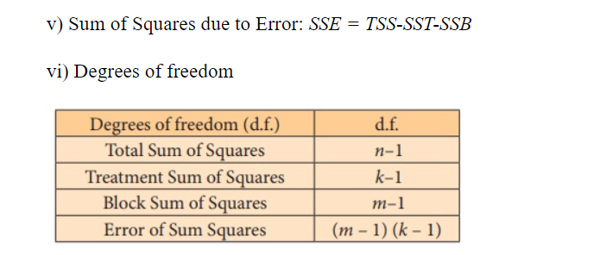

Slide 45
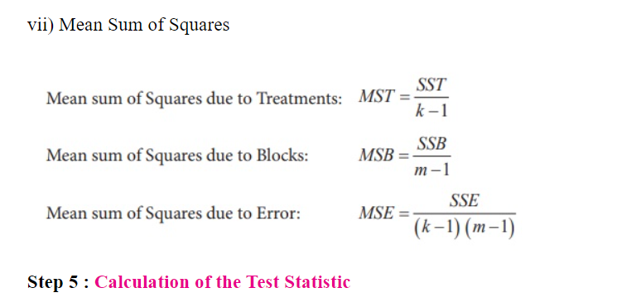

Slide 46
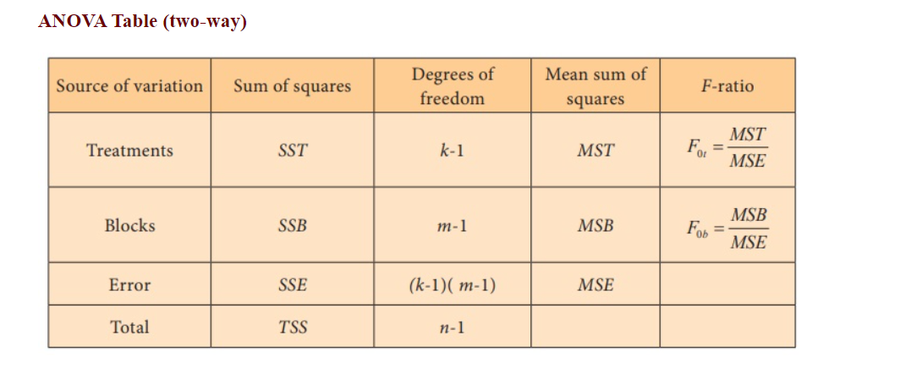

Slide 47


Slide 48

Example:1

Slide 49

For blocks
For treatments

Slide 50

Blocks
Treatments
K=no. of treatments=4
m=no. of blocks =3

Slide 51


Slide 52


Slide 53


Slide 54


Slide 55

4 salesman
no
exists
3 students

Slide 56


1)

Slide 57

2. The times required by three workers to perform an assembly-line
task were recorded on five randomly selected occasions. Here are
the times, to the nearest minute
Construct the one way ANOVA table for the data at 5% level of significance.

Slide 58

3.

Slide 59

4.

Slide 60

5. Future group wishes to enter the frozen shrimp market. They contract a
researcher to investigate various methods of groups of shrimp in large tanks.
The researcher suspects that temperature and salinity are important factor
influencing shrimp yield and conducts a two-way analysis of variance with their
levels of temperature and salinity. That is each combination of yield for each
(for identical gallon tanks) is measured. The recorded yields are given in the
following chart:

Slide 61
Thank you

